Slide 1
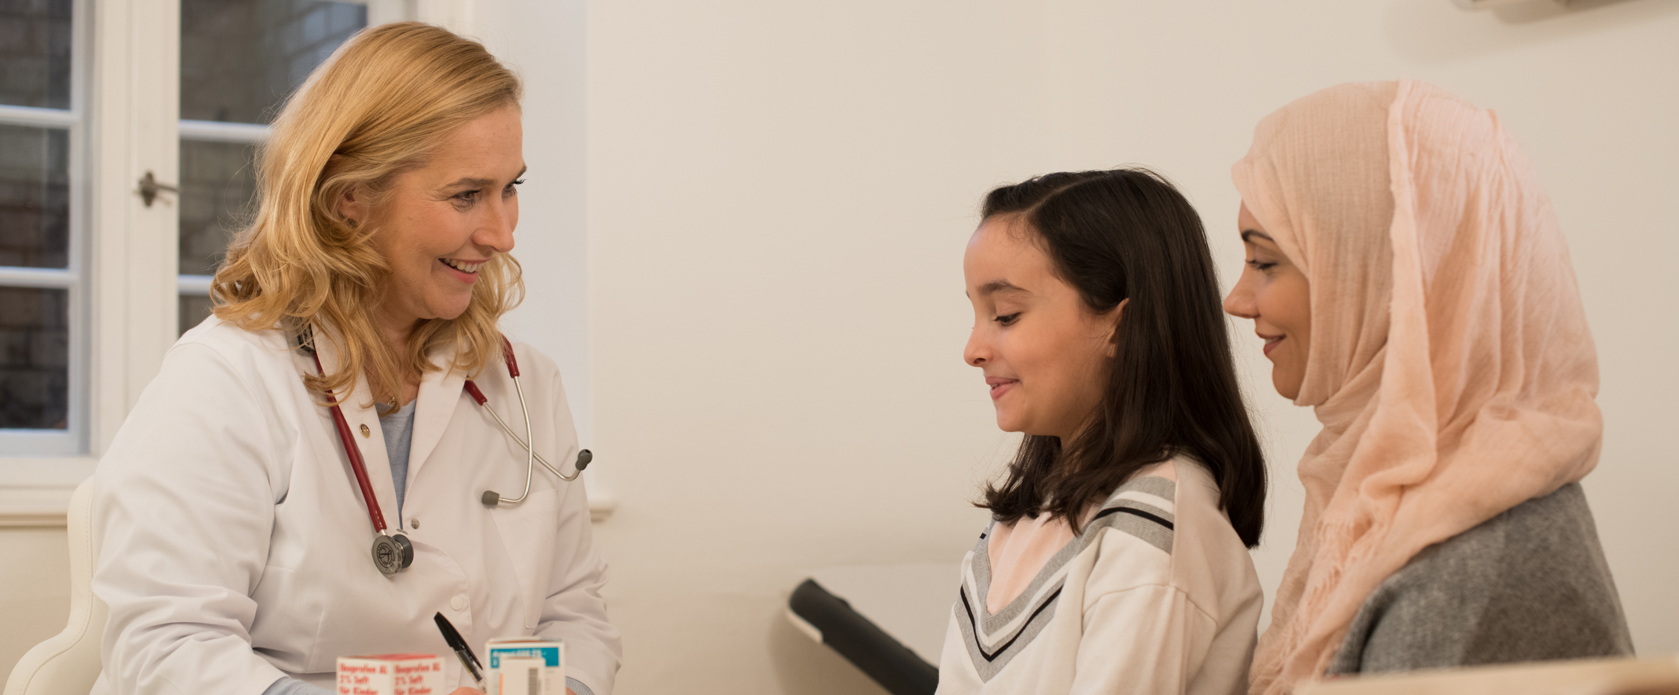
THE (our) ROTARY FOUNDATION
Doing Good in the World

Slide 2
Outstanding Performance

Slide 3
The Rotary Foundation
Doing Good
In the World Through Our
Areas of Focus

Slide 4
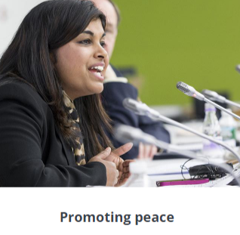
THE ROTARY FOUNDATION –Areas of Focus

Slide 5
THE ROTARY FOUNDATION –Areas of Focus

Slide 6
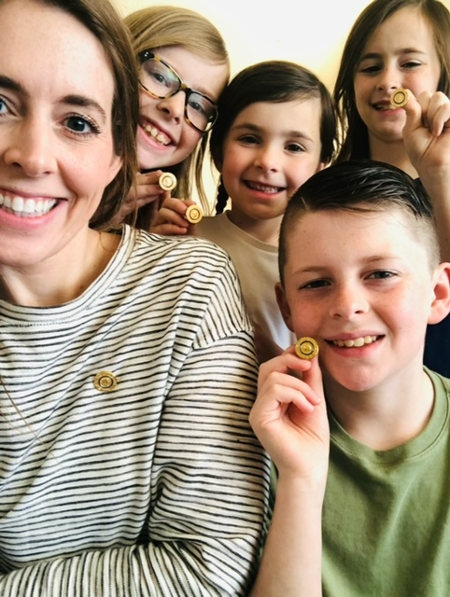
THE ROTARY FOUNDATION
DGE Heather’s Goals
Annual Giving “333 FOR TRF”
Polio Eradication-Polio Plus Society
WORLD POLIO DAY OCT 24TH
PHF, PHS, 100% PHF Club, EREY
True-up Paul Harris Clubs
Celebrate PHF, Benefactors/Bequest & Major Donors
Friendship Exchange to Croatia
District Literacy Project

Slide 7
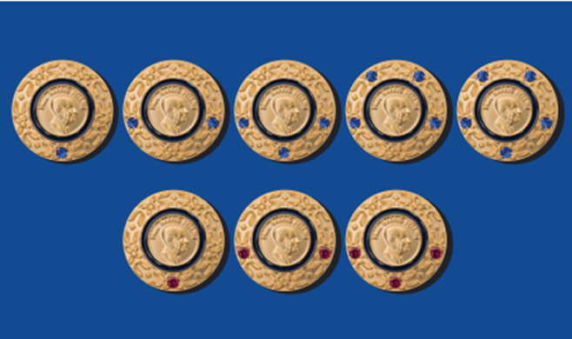
Paul Harris Fellow

Slide 8
Paul Harris Society
Recognizes consistent support of the Foundation
PHS members give 16% of Annual Fund donations
Gifts of $1,000 or more make up 45% of all Annual Fund contributions

Slide 9
Contribution Recognitions
Major Donor
Major Donor ($10,000)
Arch Klump Society ($250,000)

Slide 10
Ways to Give
Annual Fund (Every Rotarian Every Year - EREY)
Polio Fund – End Polio Now
Legacy Giving
Bequest Society ($10,000 in your will)
Benefactor ($1,000 in your will)

Slide 11
THE ROTARY FOUNDATION
ROUGHLY 3,000 MEMBERS
$1,000,000 ➗ 3,000=
$333

Slide 12
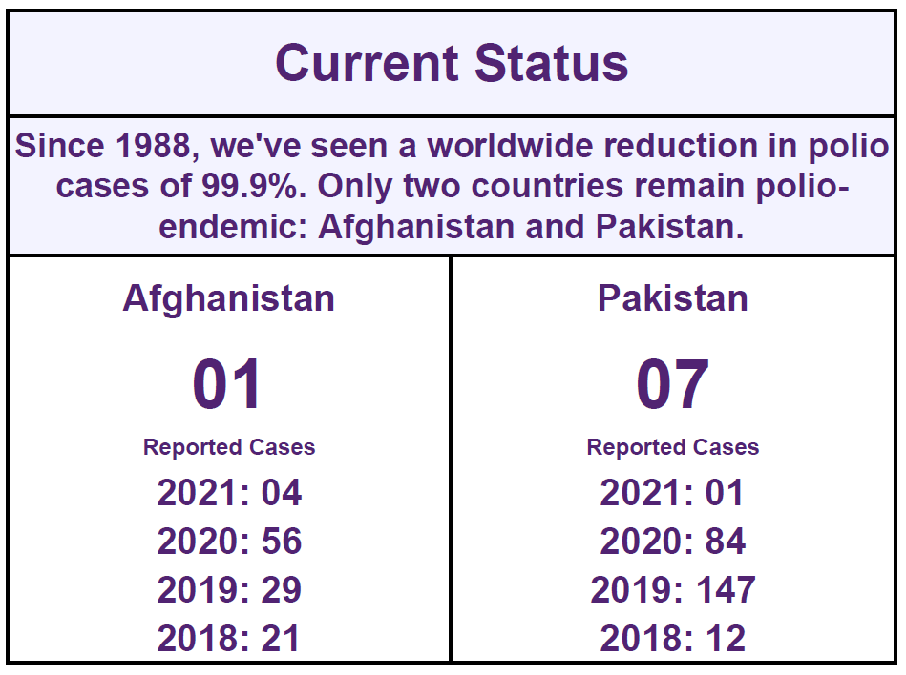
With Your Help, We Can End Polio for Good.

Slide 13
POLIO PLUS SOCIETY
$100/Year until Polio is eradicated
The University of Pittsburgh hired Dr. Jonas Salk to develop the polio vaccine.
The coin was minted in 2019 by the state of Pennsylvania to honor the discovery of the polio vaccine

Slide 14
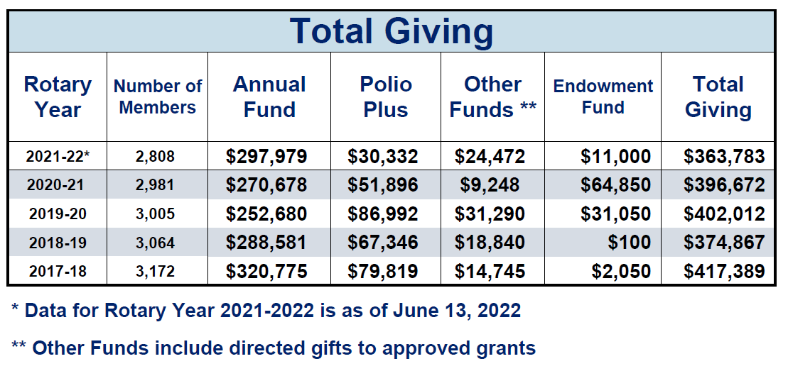
District 6920 Giving

Slide 15
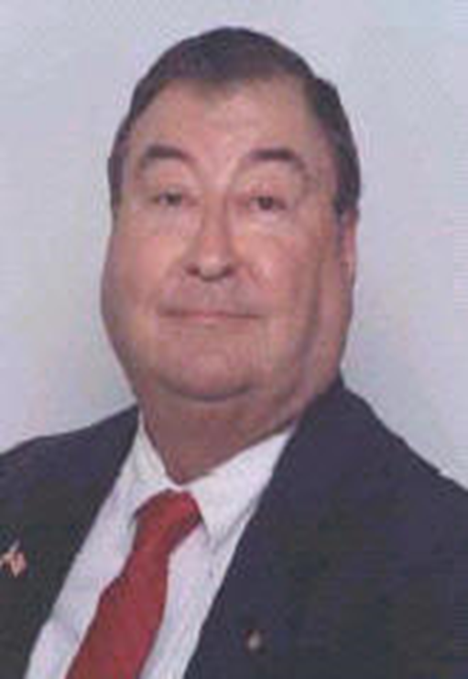
The Blankenship Cup
In Memory of William (Bill) Blankenship,
District Governor 2006-2007
Highest Giving Per Capita
To the Annual Fund
Over the Past Three (3) Rotary Years

Slide 16
2021-22 TOP FIVE CLUBS
ROTARY CLUB of
Annual Fund Per Capita
Perry
$ 478.65
Glennville
$ 457.73
Valdosta
$ 440.34
Skidaway Island
$ 261.76
Jekyll Island
$ 245.78
Notes:
-We want to thank and acknowledge all of you for giving to the Rotary Foundation.
-Before we award the cup, let’s give special recognition to the top five clubs in giving to the Annual Fund last year.

Slide 17
PAST WINNERS
2009-2010 Centerville (2 Years)
2011 Savannah Sunrise
2012-2017 Sandersville (6 Years)
2018 Glennville
2019 Glennville
2020 Glennville
2021 Glennville
2022 ????

Slide 18
2021-22 TOP FIVE CLUBS (3 Yr Avg.)
ROTARY CLUB of
THREE YEAR AVG.
Glennville
$ 384.69
Perry
$ 254.88
Macon
$ 205.32
Valdosta
$ 196.17
Jekyll Island
$ 190.93

Slide 19
CONGRATULATIONS to GLENNVILLE ROTARY!
THANK YOU!

Slide 20
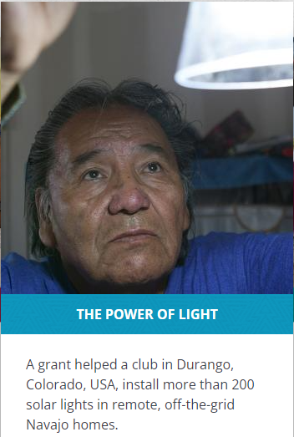
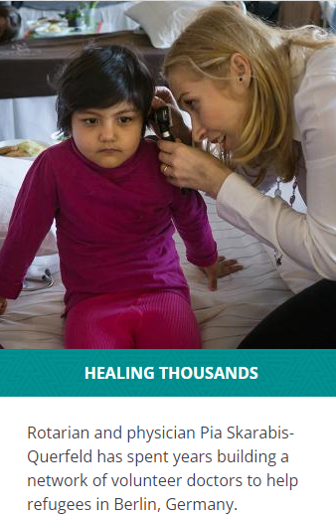
Make Our Rotary Foundation Your Charity of Choice
Automate Giving through Rotary Direct
Donate online at Rotary.org/donate
Give a check to your Club Rotary Foundation Chair
Mail your gift with the TRF Contribution Form

Slide 21
Thank You!

